Slide 1

Network Infrastructure Overview
Cloud Migration Proposal

Slide 2
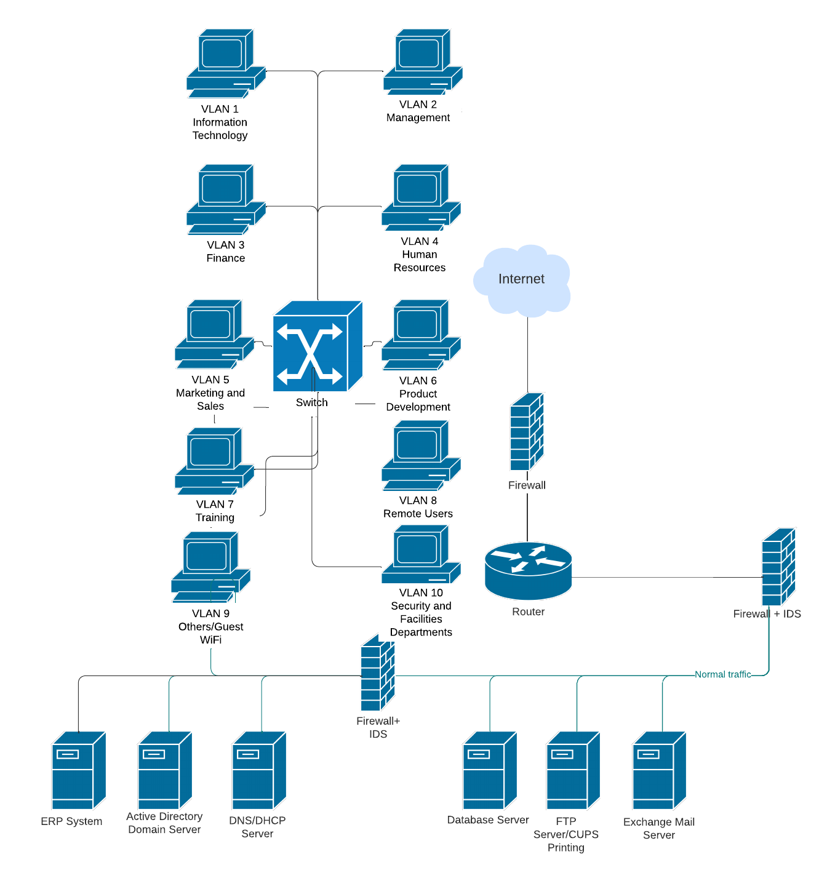
Existing Network Security Design
Domain Server 2008 EOL (End of Life)
Multiple Firewalls with outdated IDS
Multiple Points of Intrusion, such as DNS servers, FTP, Mail server, etc.

Slide 3
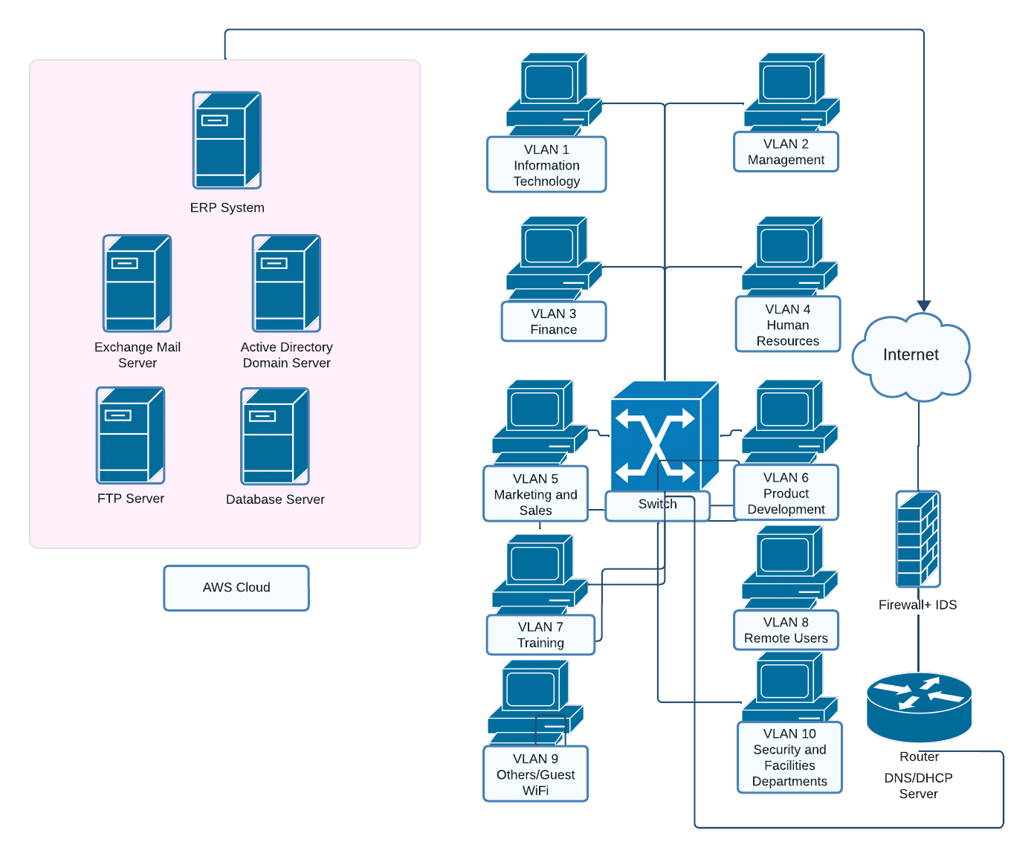
Proposed Network Security Design
AWS Direct Connect: This service allows Global Widgets to establish a dedicated network connection from their premises to an AWS Region, providing a more secure and reliable connection for their data and applications.
AWS Elastic Load Balancer: By utilizing AWS Elastic Load Balancer, Global Widgets can distribute traffic across multiple target groups or domain controllers, improving the availability and performance of their applications.
Amazon WorkSpaces: As an alternative to traditional FTP servers, Amazon WorkSpaces can provide secure access to applications, files, and resources through a cloud-based virtual desktop infrastructure (VDI) solution.
Amazon Simple Email Service (SES): Instead of relying on on-premises Exchange mail servers, Global Widgets can leverage Amazon SES to send and receive email at scale, while benefiting from built-in anti-spam and anti-virus capabilities.
Amazon DocumentDB: This fully managed document database service can help store and retrieve encrypted data, serving as a secure and scalable alternative to traditional file and print servers.
Amazon RDS (MySQL, PostgreSQL): By using Amazon RDS for MySQL or PostgreSQL, Global Widgets can maintain a fully managed database service that supports a broad range of applications without worrying about manual administration tasks.

Slide 4

Key Risks
Service availability and reliability: In a cloud environment, Global Widgets relies on AWS to maintain the availability and reliability of its IT resources. If AWS experiences an outage or degradation in service, it may negatively impact the organization's operations and productivity.
Data breaches or data loss: Cloud environments are managed by third-party service providers, which might increase the potential risk of data breaches or accidental data loss. In case of a data breach, sensitive organizational data may be exposed, harming the company's reputation and potentially leading to fines or legal penalties.
Insider threats and unauthorized access: These threats may arise from AWS employees or contractors who have access to the organization's data and resources. Such individuals could abuse their access privileges to compromise sensitive data or disrupt business operations.
Regulatory compliance and data privacy concerns: Global Widgets must ensure that its data processing and management practices in the cloud environment adhere to the relevant legal, regulatory, and industry standards, including but not limited to GDPR, HIPAA, and CCPA. Failure to do so could result in significant fines and reputational damage for the company.

Slide 5

Information Security Controls
Service Level Agreements (SLAs): Defining clear SLAs with AWS can help ensure consistent service quality and reliability, providing contractual provisions for financial penalties in case of service unavailability or disruptions.
Data encryption and key management: Implementing end-to-end encryption, both in transit and at rest, can protect sensitive organizational data from being exposed or stolen during transit. Moreover, utilizing robust key management practices can ensure that encryption keys are properly protected.
Multi-factor authentication (MFA): Implementing MFA for access to organizational resources in the cloud environment can help mitigate the risks of unauthorized access and insider threats, reducing the chances of data breaches or abuse of access privileges by malicious personnel.
Continuous security monitoring and incident response: By leveraging AWS CloudTrail and AWS Config, Global Widgets can continuously monitor and audit its cloud environment for security risks and any unauthorized changes, allowing for rapid detection and response to potential threats. Implementing a well-defined security incident response process can further mitigate the impact of potential breaches.
Regulatory compliance and data privacy management: Engaging external security auditors or utilizing cloud security assessment tools can help ensure that Global Widgets' cloud environment is fully compliant with relevant legal, regulatory, and industry standards, thus reducing the risks associated with non-compliance.

Slide 6

Changes to Network Security Architecture
Offloading security infrastructure to the cloud service provider: Global Widgets would offload much of its traditional on-premises security infrastructure (such as firewalls, intrusion detection systems, and encrypted communication channels) to a cloud service provider, which would be responsible for managing and upgrading these services.
Implementation of virtualized servers and services: Traditional on-premises servers and services would be replaced with their virtualized equivalents in the cloud, requiring a reevaluation of the security measures applied to these components.
Encrypted communication and data storage methods: All communication between clients and servers would be secured with encryption technologies, and data would be stored encrypted on cloud infrastructures. Encrypted communication channels and secure data storage can help mitigate potential threats by protecting sensitive organizational data from being exposed or stolen during transit.
Security automation and orchestration tools: Cloud providers offer tools that automate security testing and response, allowing for faster identification and remediation of security risks. These tools can help improve the overall security posture of the organization.
Scalable and flexible security configurations: Cloud environments enable rapid scaling of security measures, adapting to changing organizational requirements and threat landscapes. This flexibility can help improve the organization's ability to respond to evolving security threats.

Slide 7

Evaluation of Changes to Security Profile
Offloading security infrastructure to the cloud service provider: Relying on a AWS for security services can help reduce management overhead and maintenance costs, while also benefiting from their expertise and knowledge in managing secure data centers. However, the organization must trust that the AWS has appropriate security measures in place to protect its resources and data.
Virtualizing servers and services: By virtualizing traditional on-premises infrastructure, Global Widgets can benefit from improved scalability, management, and cost efficiency. However, virtual layers introduce new vulnerabilities and attack surfaces that must be carefully managed and secured.
Implementing encrypted communication and data storage methods: Employing encryption technologies can help protect sensitive organizational data from being exposed or stolen during transit. However, the complexity of managing encryption keys and the potential impact on performance must be considered.
Leveraging security automation and orchestration tools: Automated security testing and response tools can help improve the organization's ability to respond to evolving security threats. However, these tools will have to be appropriately configured and managed to ensure they are effective in detecting and mitigating potential breaches.
Embracing scalable and flexible security configurations: Cloud environments offer rapid scaling of security measures, adapting to changing organizational requirements and threat landscapes. This flexibility can help improve the organization's ability to respond to evolving security threats. However, it is essential to understand the potential risks associated with rapid scaling, such as creating new vulnerabilities or disconnecting existing security measures.

